Slide 1
3.6 Binary Input/Output
Department of CSE

Slide 2
Objectives
To understand operations on text and binary files
To understand the differences between text and binary files
To write programs that read, write, and/or append text and binary files
Department of CSE

Slide 3
Text File vs Binary File
Text files are divided into lines. Each byte in a text file represents a character, therefore readable by humans
In binary files, each byte may not be a character.
Text File | Binary File
All data are human readable graphic characters | Data are stored in internal (binary) computer format
Each line of data ends with a “New Line” character | There are no lines or new lines. Data is in a continuous stream.
A special Character (EOF) marks the end of the file | An EOF character marks the end of the file
NOTE : Formatted input/output(printf,scanf) , character input/output(getchar, putchar), and string input/output(fgets, fputs) functions can be used only with text files.

Slide 4
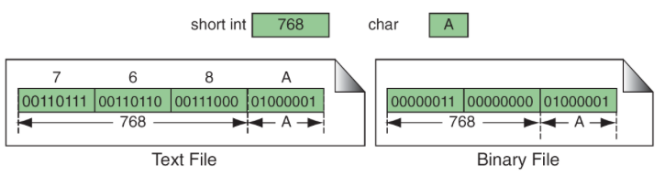
An Example
Text File stores “768” as three numeric characters and “A” as single character.
Binary File stores “768” as a single short int character of 2 bytes and character “A” as a single character of size one byte.
Note: Text files store data as a sequence of characters; binary files store data as they are stored in primary memory.

Slide 5
State of File
Files can be opened in Read, Write or Error State
To read from a file - open in Read state
To write into a file - open in Write state
Error state - Occurs when a read operation is attempted on a file opened in Write state or vise versa. Note: A file opened in “read” state must already exist. Otherwise the open fails.
Files can be opened in various states based on the file mode statements

Slide 6
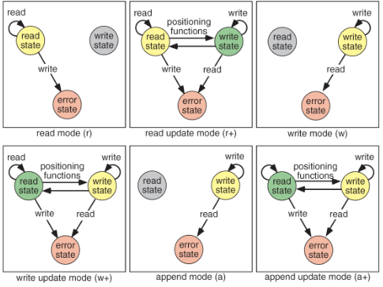
File Modes

Slide 7
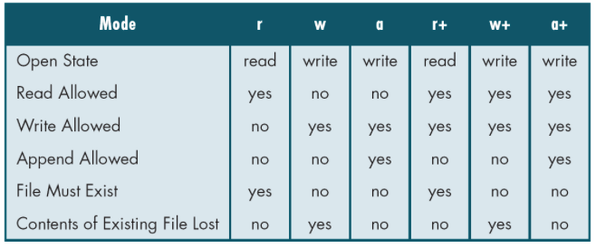
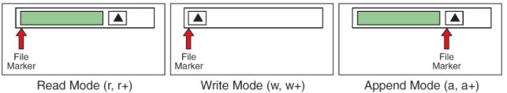
File Modes Continued.
Position of the EOF marker for each mode

Slide 8
File operations
Open a file: fopen()
Close a file: fclose()
Read a binary file: fgetc(), getc(), fgets(), puts(), fscanf(), fread()
Write a binary file: fputc(), putc(), fputs(), puts(), fprintf(), fwrite()
File positioning: fseek(), ftell(), fgetpos(), fsetpos()

Slide 9
fopen()
FILE *fopen(char *name, char *mode);
void fclose(FILE* stream)
fopen returns a pointer to a FILE.
mode can be
“r” - read
“w” - write
“a” - append
“b” can be appended to the mode string to work with binary files. For example, “rb” means reading binary file.

Slide 10
Text Files – fprintf()
int fprintf(FILE *fp, char *format, ...);
Similar to printf.
On success, the total number of characters written is returned. If a writing error occurs, a negative number is returned.

Slide 11
Example – create and write to a file
#include <stdio.h>
int main()
{
FILE *fp;
char name[10];
double balance;
int account;
if ((fp = fopen(“clients.dat”, “w”)) == NULL) {
printf(“File could not be opened\n”);
}
else {
printf(“Enter one account, name, and balance.\n”);
scanf(“%d%s%lf”, &account, name, &balance);
fprintf(fp, "%d %s %.2f\n", account, name, balance);
fclose(fp);
}
return 0;
}

Slide 12
Text Files – fscanf()
int fscanf(FILE *fp, char *format, ...);
Similar to scanf.
On success, return the number of items successfully filled. This count can match the expected number of items or be less (even zero) due to a matching failure, a reading error, or the reach of the end-of-file. And, if end-of-file happens before any data could be successfully read, EOF is returned.
int feof(FILE *fp);
return 1/0 end-of-file is reached

Slide 13
Text Files – read from a file
#include <stdio.h>
int main()
{
FILE *fp;
char name[10];
double balance;
int account;
if ((fp = fopen(“clients.dat”, “r”)) == NULL) {
printf(“File could not be opened\n”);
}
else {
fscanf(fp, “%d%s%lf”, &account, name, &balance);
printf("%d %s %.2f\n", account, name, balance);
fclose(fp);
}
return 0;
}

Slide 14
Text Files – character I/O
int fputc(int c, FILE *fp);
int putc(int c, FILE *fp);
Write a character c to a file. putc() is often implemented as a MACRO (hence faster). On success, the character written is returned. If a writing error occurs, EOF is returned
int fgetc(FILE *fp);
int getc(FILE *fp);
Read a character c to a file. getc() is often implemented as a MACRO (hence faster). On success, the character read is returned. If a read error occurs, EOF is returned.

Slide 15
Text Files – character I/O
#include <stdio.h>
int main()
{
FILE *source_fp, *dest_fp;
int ch;
if ((source_fp = fopen("source.txt", "r")) == NULL)
printf("cannot open source file\n");
if ((dest_fp = fopen("dest.txt", "w")) == NULL)
printf("cannot open dest file\n");
while ((ch = getc(source_fp)) != EOF)
putc(ch, dest_fp);
fclose(source_fp);
fclose(dest_fp);
return 0;
}

Slide 16
Text Files – character I/O
int ugetc(int c, FILE *fp);
Push back a character read from a file pointer.
int feof(FILE *fp);
return 1/0 end-of-file is reached

Slide 17
Text Files – character I/O
#include <stdio.h>
int main ()
{
FILE * fp;
int c;
fp = fopen ("source.txt","r");
if (fp == NULL) {
printf("cannot open the file\n");
return 0;
}
while (!feof (fp)) {
c = getc(fp);
if (c == '#')
ungetc('@', fp);
else
putc(c, stdout); // stdout is the screen
}
return 0;
}

Slide 18
Text Files – standard input & output
FILE *stdin // screen input as a file
FILE *stdout // screen output as a file

Slide 19
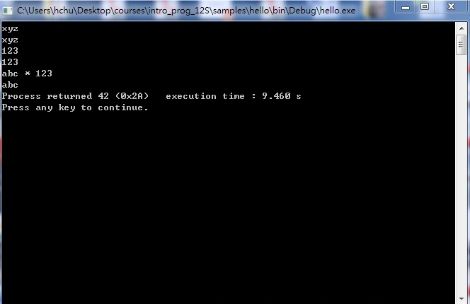
Text Files – stdin, stdout
#include <stdio.h>
int main ()
{
int c;
while ((c = fgetc(stdin)) != '*')
{
fputc(c, stdout);
}
}

Slide 20
Text Files – Line I/O
int fputs(const char *s, FILE *fp);
Write a line of characters to a file. On success, a non-negative value is returned. On error, the function returns EOF.
char* fgets(char *s, int n, File *fp);
Read characters from a file until it reaches the first new-line or (n-1) characters, in which it places the NULL character (‘\0’) at the end of the string.
On success, the function returns s. If the end-of-file is encountered before any characters could be read, the pointer returned is a NULL pointer (and the contents of s remain unchanged).

Slide 21
Text Files – Line I/O
#include <stdio.h>
int main()
{
FILE *source_fp, *dest_fp;
char s[100];
if ((source_fp = fopen("source.txt", "r")) == NULL)
printf("cannot open source file\n");
if ((dest_fp = fopen("dest.txt", "w")) == NULL)
printf("cannot open dest file\n");
while (fgets(s, 100, source_fp) != NULL)
fputs(s, dest_fp);
fclose(source_fp);
fclose(dest_fp);
return 0;
}

Slide 22
Opening Binary Files
Syntax: FILE* fopen (const char* filename, const char* mode);
The six binary file modes are
Mode | Command
Read Binary | rb
Write Binary | wb
Append Binary | ab
Read and Update Binary | r+b
Write and Update Binary | w+b
Append and Update Binary | a+b

Slide 23
Examples
The following are examples of open statements for binary files
// Write into a binary file FILE *fpWriteBin; fpWriteBin=fopen("c:\\myFile.bin", “wb”);
// Read from a binary file fpReadBin = fopen (“myFile.bin”, “rb”);
// Write with update fpWriteUpdateBin = fopen (“myFile.bin”, “w+b”);
// Append to a binary file fpApndBin = fopen (“myFile.bin”, “ab”);

Slide 24
Closing a Binary File
This is the same as closing a text file int fclose (fpReadBin);

Slide 25
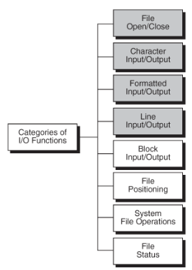
Standard Library Functions for Files
C has eight categories of standard file library functions.
The first 4 are already discussed

Slide 26
File operations
Open a file: fopen()
Close a file: fclose()
Read a binary file: fgetc(), getc(), fgets(), puts(), fscanf(), fread()
Write a binary file: fputc(), putc(), fputs(), puts(), fprintf(), fwrite()
File positioning: fseek(), ftell(), fgetpos(), fsetpos()

Slide 27
1. Block I/O Functions
Used to read and write data into binary files as discussed previously.
With the exception of character data, we cannot “see” data in binary files. If opened in an editor it looks like hieroglyphics.
This is because there are no format conversions .
fread( ) and fwrite( ) are the block read and write functions.

Slide 28
1. Block I/O Functions Continued.
File Read : fread( )
reads a specified number of bytes from a binary file and places them into memory at the specified location.
Syntax: int fread( void* pInArea, int elementSize, int count, FILE* sp);
pInArea is a pointer to the input area in memory
elementSize & count are multiplied to determine the amount of data to be transferred.
the last parameter (sp)is the associated stream

Slide 29
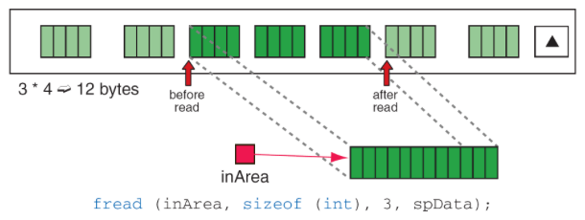
1. Block I/O Functions – fread( ).
An example of a file that reads data into an array of integers
fread() transfers the next 3 integers from the file(spData) to the array(inArea)
If only 2 integers are left to read fread() will return 2

Slide 30
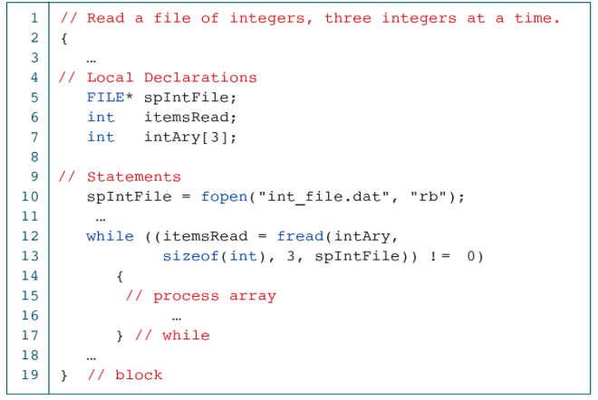
1. Block I/O Functions – fread( ).
Program: read a file of integers

Slide 31
1. Block I/O Functions – fread( ).
fread( ) returns the number of items read
In the previous figure it will range from 0-3
A more common use: - Reading Structures (records)
Advantage: Structures contain a variety of data (string, int, float,etc.)
Block I/O functions can transfer data one structure(record) at a time
No need to format data

Slide 32
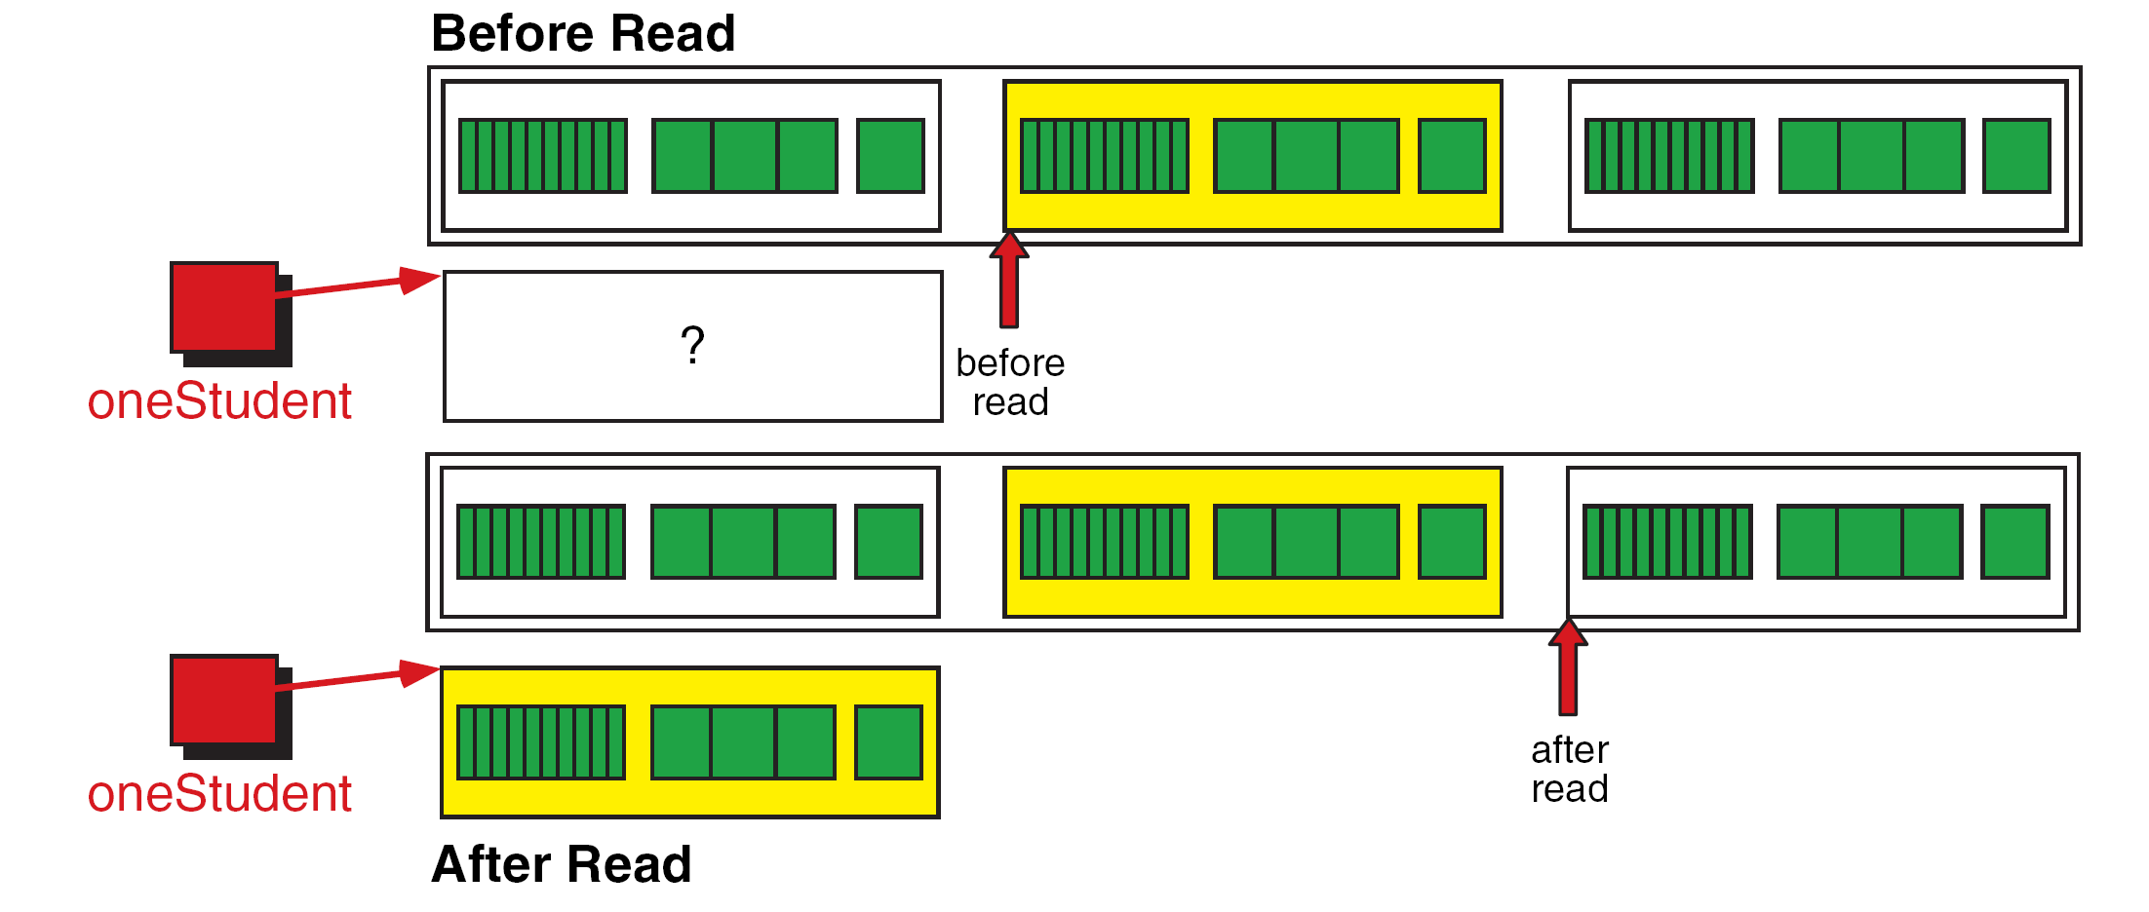
1. Block I/O Functions – fread( ).
Reading a Structure

Slide 33
1. Block I/O Functions continued.
Program: Read Student File

Slide 34
1. Block I/O Functions – fwrite( ).
Writes a specified number of items to a binary file
Syntax int fwrite (void* pOutArea, int elementSize, int count, FILE* sp);
The parameters for file write correspond exactly with the parameters for fread( ).
It returns the number of items written.
Eg: if it writes 3 integers, it returns 3
If the number of items written is fewer than count, then error
Fwrite copies elementSize x count bytes from the address specified by pOutArea to the file

Slide 35
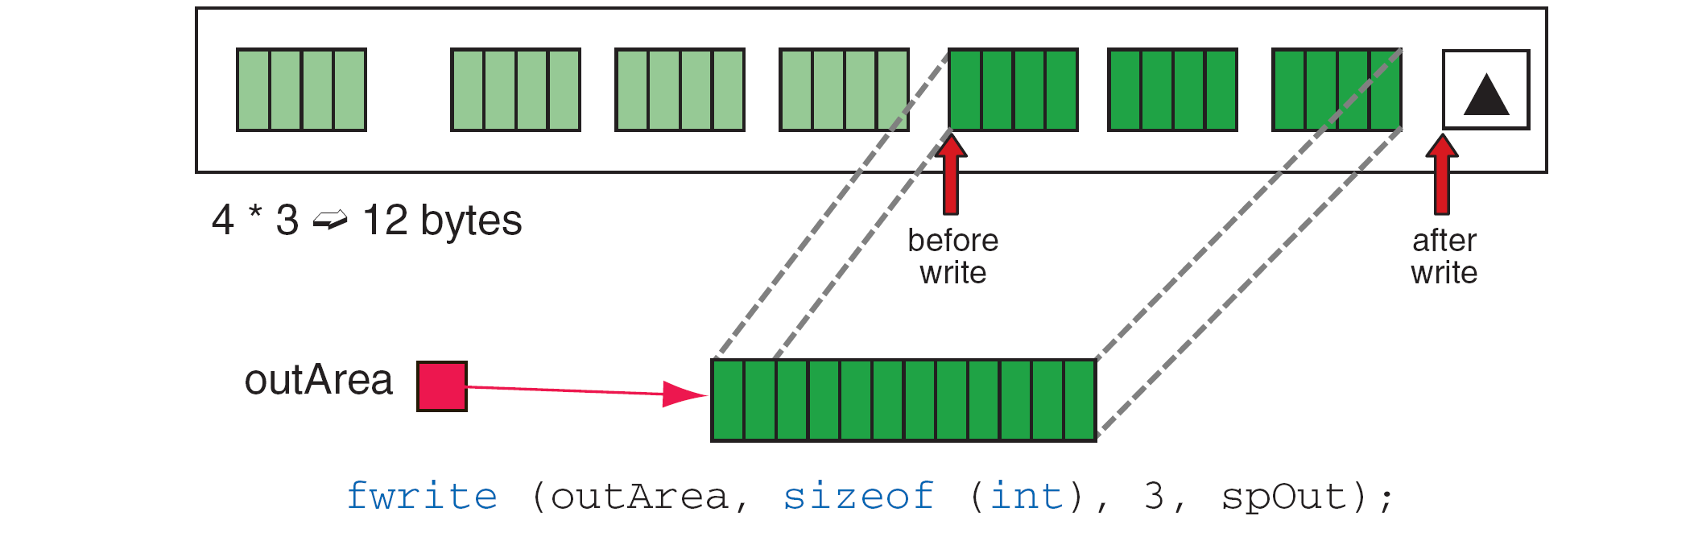
1. Block I/O Functions – fwrite( ).
File Write Operation

Slide 36
1. Block I/O Functions – fwrite( ).
Writing a Structure

Slide 37
1. Block I/O Functions – fwrite( ).
Program: Writing Structured Data

Slide 38
2. File Positioning
These have 2 uses:
For randomly processing data in disk files – position the file to read the desired data.
Change a file state ( from read to write, etc.)
There are 3 functions
Rewind – rewind( )
Tell location – ftell( )
File seek – fseek( )

Slide 39
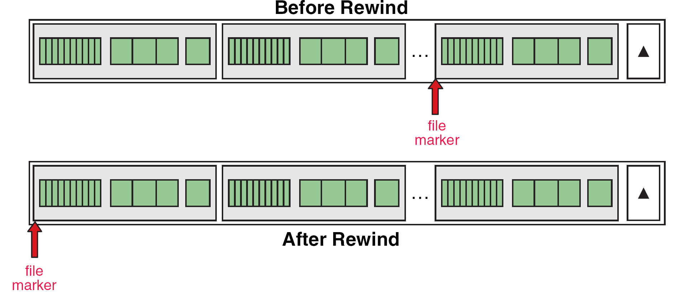
2. File Positioning – rewind( )
Sets the file position indicator to beginning of file

Slide 40
2. File Positioning – rewind( )
Syntax: void rewind( FILE* stream);
A common use: change a work file from write state to read state
NOTE: recollect that to read and write a file with one open, we must open it in update mode(w+ or w+b).
Though the same can be achieved by closing and reopening a file, rewinding is a faster operation.

Slide 41
2. File Positioning – ftell( )
Reports current position of file marker in file relative to the beginning of the file
Measures position in bytes starting from zero
Returns a long integer
Syntax: long int ftell ( FILE* stream);

Slide 42
2. File Positioning – ftell( )
To find number of structures relative to first structure, it must be calculated.
Example numChar = ftell(sp); numStruct = numChar / sizeof(STRUCTURE_TYPE);
Here each structure is 4 bytes. If ftell() returns 16, it implies that there are 4 structures before this one.
If ftell() encounters an error it returns “-1”.
There are 2 conditions for error
Using ftell() with a device that cannot store data
When position is larger than long int

Slide 43
3. File Positioning – fseek( )
Positions the file location indicator to the specified byte position in the file
Syntax: int fseek( FILE* stream, long offset, int wherefrom);
The first parameter is a pointer to the open file(either rea/write)
Second parameter is a signed integer that specifies the number of bytes : absolutely or relatively.

Slide 44
3. File Positioning – fseek( )
C provides 3 named constants that specify the start position (wherefrom) of the seek operation
#define SEEK_SET 0
#define SEEK_CUR 1
#define SEEK_END 2
When wherefrom is SEEK_SET or 0, the offset is measured absolutely from the beginning of the file
Example: to set file indicator to byte 100 on a file the syntax is fseek(sp, 99L, SEEK_SET);

Slide 45
3. File Positioning – fseek( )
When wherefrom is set to SEEK_CUR or 1, the displacement is calculated from the current file position.
If the displacement is negative, the file position moves to the beginning of the file and if displacement is positive, it moves towards the end of the file.
It is an error to move beyond the beginning of a file
The file is extended if the marker moves beyond the end of the file but the contents of the extended bytes are unknown.
Example: To position the file marker to the next record in a structured file fseek(sp, sizeof(STRUCTURE_TYPE), SEEK_CUR);

Slide 46
3. File Positioning – fseek( )
If wherefrom is SEEK_END or 2, the file locator indicator is positioned relative to the end of the file.
This is used to write a record to the end of the file as shown below fseek(stuFile,0L,SEEK_END);
This returns 0 if the positioning is successful and returns a non zero value if unsuccessful.

Slide 47
3. File Positioning – fseek( )

Slide 48
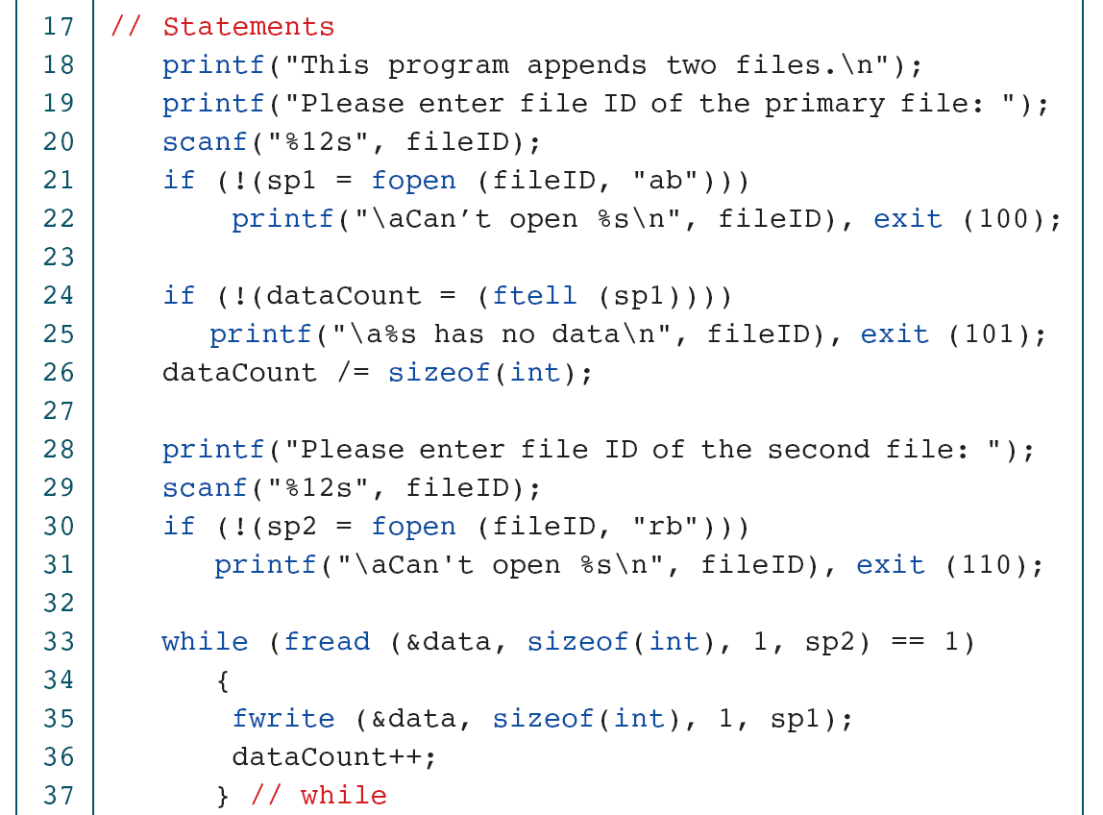
Example: Program to Append 2 Binary Files
Department of CSE

Slide 49
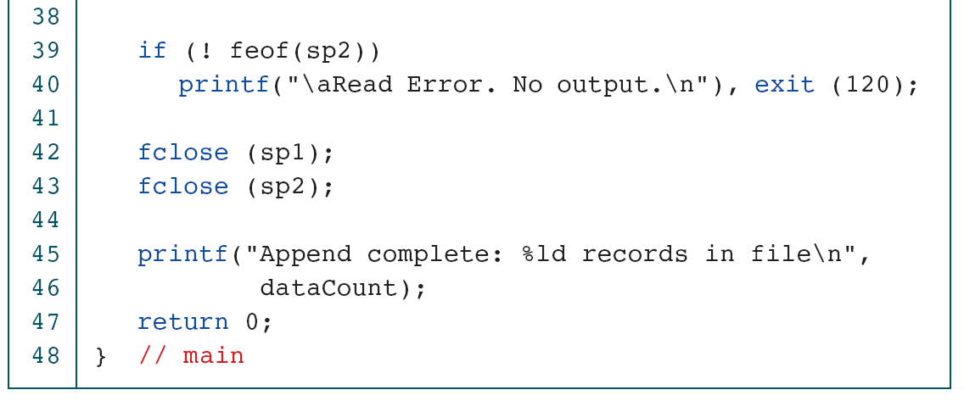
Example: Program to Append 2 Binary Files Cont.
Department of CSE

